Slide 1

Direct extraction of path weak values from interferograms without auxiliary qubits
I. V. Masiello¹, A. Dvorak¹, H. Lemmel^{1,2}, and Y. Hasegawa^{1,3}
¹Atominstitut, TU Wien, Stadionallee 2, 1020 Vienna, Austria
²Institut Laue-Langevin, 71 avenue des Martyrs, 38000 Grenoble, France
³Department of Applied Physics, Hokkaido University, Kita-ku, Sapporo 060-8628, Japan

Slide 2
Contents

Slide 3
Contents
Introduction to weak values in the context of weak Von Neumann measurements

Slide 4
Contents
Introduction to weak values in the context of weak Von Neumann measurements
Weak value based description of Mach-Zehnder interferometry

Slide 5
Contents
Introduction to weak values in the context of weak Von Neumann measurements
Weak value based description of Mach-Zehnder interferometry
Experiment and results

Slide 6
Introduction to weak values

Slide 7

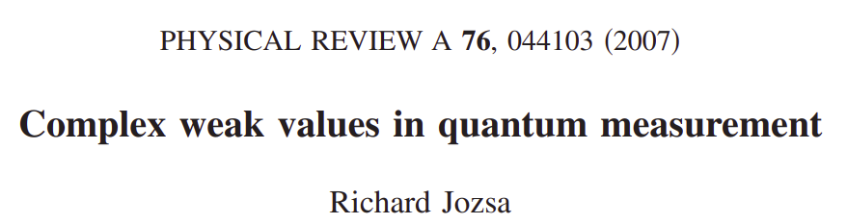
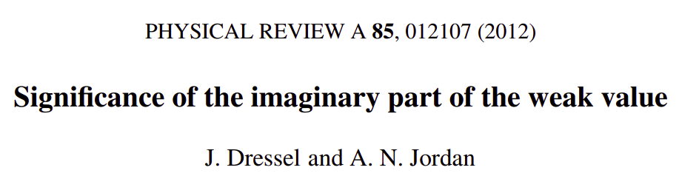

Slide 8
Definition

Slide 9


Definition
Weak value:

Slide 10
Definition
Weak value:

Slide 11
Definition
Observable:
Pre-selected state:
Post-selected State:
Weak value:

Slide 12

Definition
Observable:
Pre-selected state:
Post-selected State:
Weak value:
Expectation value:

Slide 13
Definition
Observable:
Pre-selected state:
Post-selected State:
Complex number
Weak value:
Expectation value:

Slide 14
Definition
Observable:
Pre-selected state:
Post-selected State:
Complex number
Not bounded by eigenvalues
Weak value:
Expectation value:

Slide 15
Von Neumann measurement
Ingredients:

Slide 16
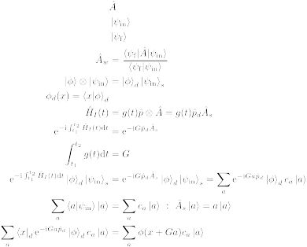
Von Neumann measurement
Ingredients:
Two quantum states

Slide 17
Von Neumann measurement
Ingredients:
Two quantum states
Pointer
System

Slide 18
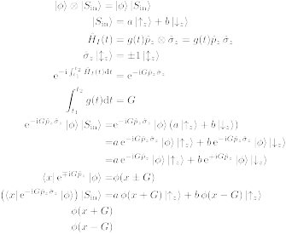
Von Neumann measurement
Ingredients:
Two quantum states
State evolution

Slide 19

Von Neumann measurement
Ingredients:
Two quantum states
State evolution
Translation operator

Slide 20
Von Neumann measurement
Ingredients:
Two quantum states
State evolution
Translation operator

Slide 21
Von Neumann measurement
Stern-Gerlach

Slide 22
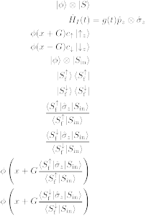

Von Neumann measurement
Stern-Gerlach

Slide 23
Von Neumann measurement
Stern-Gerlach
Position
Spin

Slide 24
Von Neumann measurement
Stern-Gerlach
N
S

Slide 25

Von Neumann measurement
Stern-Gerlach
N
S

Slide 26
Von Neumann measurement
Stern-Gerlach
N
S

Slide 27
Von Neumann measurement
Stern-Gerlach

Slide 28
Von Neumann measurement
Stern-Gerlach
State evolution

Slide 29
Von Neumann measurement
Stern-Gerlach
State evolution

Slide 30
Von Neumann measurement
Stern-Gerlach
State evolution

Slide 31
Von Neumann measurement
Stern-Gerlach

Slide 32
Von Neumann measurement
Stern-Gerlach

Slide 33
Von Neumann measurement
Stern-Gerlach

Slide 34
Von Neumann measurement
Stern-Gerlach

Slide 35
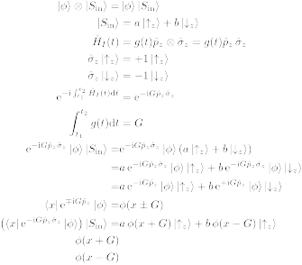
Von Neumann measurement
Stern-Gerlach

Slide 36
Von Neumann measurement
Stern-Gerlach

Slide 37
Von Neumann measurement
Stern-Gerlach
Translation operators

Slide 38
Von Neumann measurement
Stern-Gerlach

Slide 39
Von Neumann measurement
Stern-Gerlach

Slide 40
Von Neumann measurement
Stern-Gerlach

Slide 41
Von Neumann measurement
Stern-Gerlach
N
S

Slide 42
Weak measurement
Stern-Gerlach

Slide 43
Weak measurement
Stern-Gerlach
N
S

Slide 44
Weak measurement
Stern-Gerlach
N
S

Slide 45
Weak measurement
Stern-Gerlach
N
S

Slide 46
Weak measurement
Stern-Gerlach
N
S

Slide 47
Weak measurement
Stern-Gerlach
N
N
S
S

Slide 48
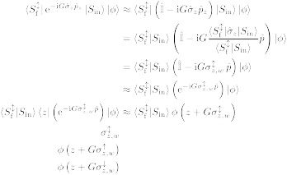
Weak measurement
Stern-Gerlach

Slide 49
Weak measurement
Stern-Gerlach

Slide 50
Weak measurement
Stern-Gerlach

Slide 51
Weak measurement
Stern-Gerlach

Slide 52
Weak measurement
Stern-Gerlach

Slide 53
Weak measurement
Stern-Gerlach

Slide 54
Weak measurement
Stern-Gerlach

Slide 55
Weak measurement
Stern-Gerlach

Slide 56
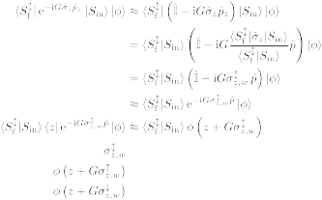
Weak measurement
Stern-Gerlach

Slide 57
Weak measurement
Stern-Gerlach
Translation operator

Slide 58
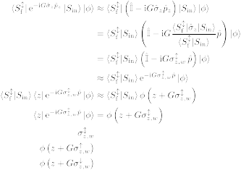
Weak measurement
Stern-Gerlach

Slide 59
Weak measurement
Stern-Gerlach

Slide 60
Weak measurement
Stern-Gerlach
N
N
S
S

Slide 61
Introduction to weak values

Slide 62
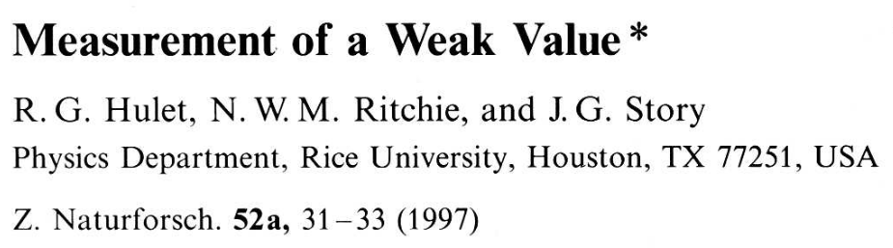
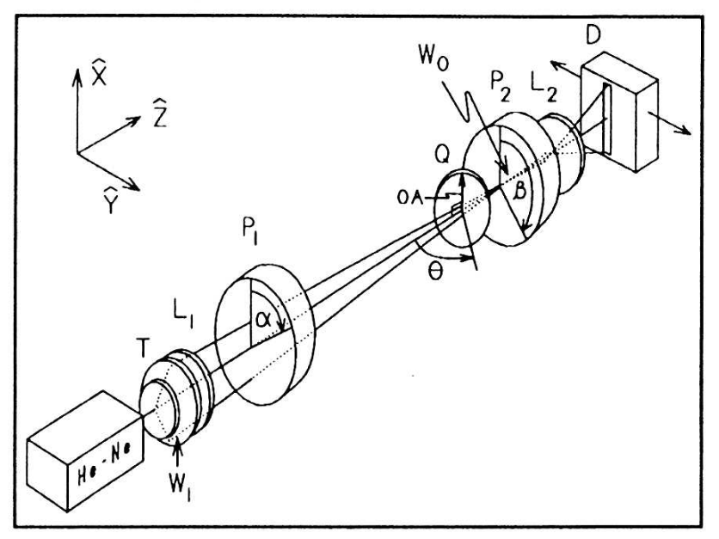
Introduction to weak values

Slide 63
WEAK VALUE
WEAK MEASUREMENT

Slide 64
Is the weak value always weak?
Weak value:

Slide 65
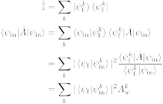
Is the weak value always weak?
Expectation value:

Slide 66
Is the weak value always weak?
Expectation value:

Slide 67
Is the weak value always weak?
Expectation value:

Slide 68
Is the weak value always weak?
Expectation value:

Slide 69
Is the weak value always weak?
Expectation value:

Slide 70
Is the weak value always weak?
Expectation value:

Slide 71
CAN WEAK VALUES DESCRIBE INTERFEROMETRY?

Slide 72



Weak values and interferometry
Standard interferometry formalism

Slide 73
Weak values and interferometry
Standard interferometry formalism

Slide 74
Weak values and interferometry
Standard interferometry formalism

Slide 75
Weak values and interferometry
Standard interferometry formalism

Slide 76
Weak values and interferometry
Standard interferometry formalism

Slide 77
Weak values and interferometry
Standard interferometry formalism

Slide 78

Weak values and interferometry
Standard interferometry formalism
Measured intensity

Slide 79
Weak values and interferometry
Standard interferometry formalism
Measured intensity

Slide 80
Weak values and interferometry
Standard interferometry formalism
Measured intensity

Slide 81
Weak values and interferometry
Standard interferometry formalism
Measured intensity

Slide 82
Weak values and interferometry
Weak value picture
Pre-selection

Slide 83
Weak values and interferometry
Weak value picture
Pre-selection
Interaction

Slide 84

Weak values and interferometry
Weak value picture
Pre-selection
Interaction

Slide 85
Weak values and interferometry
Weak value picture
Pre-selection
Interaction
Post-selection

Slide 86
Weak values and interferometry
Weak value picture
Measured intensity

Slide 87
Weak values and interferometry
Weak value picture
Measured intensity

Slide 88
Weak values and interferometry
Weak value picture
Measured intensity

Slide 89
Weak values and interferometry
Weak value picture
Measured intensity
Path weak value

Slide 90
Weak values and interferometry
Weak value picture
Measured intensity

Slide 91
Weak values and interferometry
Weak value picture
Measured intensity

Slide 92
Weak values and interferometry
Weak value picture
Measured intensity

Slide 93
Weak values and interferometry
Weak value picture
Measured intensity
Amplitude
square

Slide 94
Weak values and interferometry
Weak value picture
Measured intensity
Real part
Amplitude
square

Slide 95
Weak values and interferometry
Weak value picture
Measured intensity
Real part
Amplitude
square
Imaginary
part

Slide 96
Weak values and interferometry
Weak value picture
Measured intensity

Slide 97

Weak values and interferometry
Weak value picture
Measured intensity

Slide 98
Weak values and interferometry
Weak value picture
Measured intensity

Slide 99
Weak values and interferometry
Weak value picture
Measured intensity

Slide 100
Weak values and interferometry
Weak value picture
Measured intensity

